Slide 1
Lending Case Study EDA
By – Rahul Prashar

Slide 2
Contents
Data & Business Understanding
Data Cleaning
Standardizing Values
Finding Outliers
Data Analysis
Conclusion

Slide 3
Data & Business Understanding
Company wants to understand the driving factor behind loan default, the company can use these indicators for portfolio risk assessment
Given dataset has three categories:
Fully Paid
Default
Current
Current loan cannot be tagged as defaulted or repaid, so they can be ignored for the analysis
Data Highlights
There are 39,717 rows and total of 111 columns out of which 87 are numeric columns and 24 are objects
There are many fields with lot of missing values, it needs to be dropped

Slide 4
Data Cleaning
1. Cleaning Null Values:
A user-defined function missing_data has been used to identify fields with percentage of null values
Insights:
There are 68 fields with missing values
Need to check how many columns have more than 50% missing values, we can drop such columns for further analysis
2. Fixing Columns:
Interest Rate column had been read as Object variable, it has been converted into numeric type for better analysis and insights
3. Cleaning Non-Numerical Columns:
emp_title, pymnt_plan, url, title, zip_code, initial_list_status to be removed as they don't have sufficient information for example - zip code or are redundant in case of url it looks like the extension of ID
4. Cleaning numerical columns:
collections_12_mths_ex_med, acc_now_delinq, chargeoff_within_12_mths, delinq_amnt, tax_liens can be removed as it has all zeroes
policy_code can be removed as it has only 1 value

Slide 5
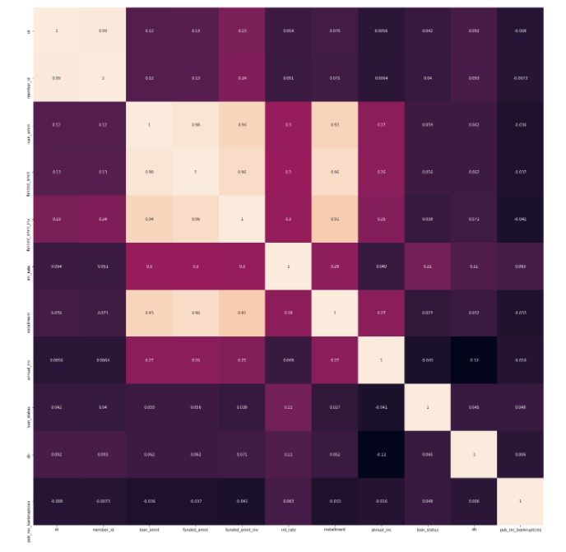
Data Cleaning contd.
Correlation has been performed to remove highly correlated numeric values
Above correelation matrix tells that there is a high correlation between id and member id, any one of them could be taken for further analysis
Loan_amnt, funded_amnt, funded_amnt_inv and installment are highly correlated, any one of them can be taken for further analysis
Loan_amt can be retained as the business objective of this case study is to for the approver to decide whether the loan should be given or not so loan_amt is the most important field out of the other highly correlated one stated in the above point

Slide 6
Standardizing Values
We can see that fields such as loan_amnt, annual_inc , dti have very high volume and lot of results – using describe function
We can have categorical fields as well for them by creating bins for better analysis
Bins have been created
Loan_amount_range
Annual_income_range
Interesr Rate Range

Slide 7
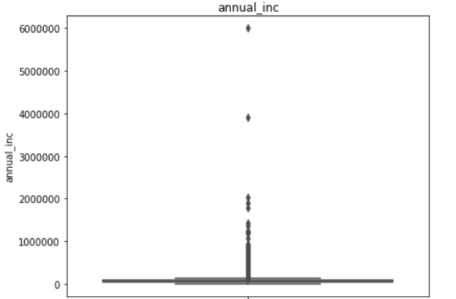
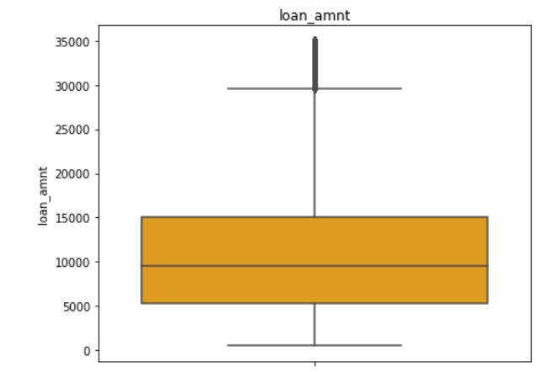
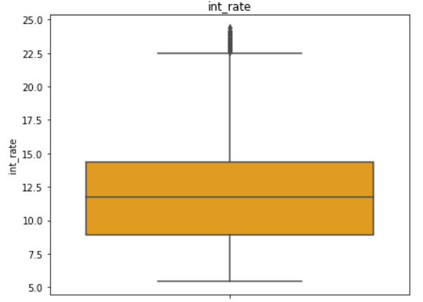
Outliers
By using the describe method we can see that there are outliers in loan_amount, interest Rates and annual income as the difference between max and 75% is high
By plotting the fields using box-plot we get below insights:
Loan amount and interest rate have some outliers
Annual income has huge number of outliers, it means that for loan application there are few people with very high income compared to common cohort

Slide 8
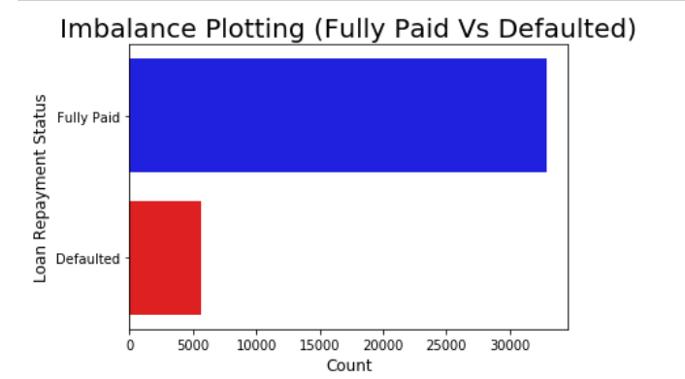
Data Analysis
Imbalance in data
Fully Paid applicant is 85.41%
Defaulter percentage is 14.6% in the data
For Every 5.85 fully paid applicant there is 1 defaulter

Slide 9
Data Analysis contd.
As we must perform univariate analysis on multiple fields both numeric and categorical, I have created a user-defined functions which takes dataset, variable and target variable as parameters
Output of the function is a distribution plot for numerical variable
Output of the function is count plot for a categorical variable

Slide 10
Conclusion
After performing the univariate and bi-variate analysis in the python notebook below are my recommendation for the Approver
Loan Amount should be taken into factor as we saw higher loan amount leads to more defaulters
Term length of the loan can be kept shorter, we have observed higher defaults when term length is 60 months
Grade F&G have higher default percentage, going deeper we saw that sub-grades G3 and F5 have the highest defaults, grades and sub-grades should be considered while approving loan
Verification should be done thoroughly; we have observed higher default% even if the verification status = "Verified"
Interest Rate can be optimized, 10-14% looks best for the business, interest rate > 16% tends to more defaults in the loan
Annual income Range with <20K shows maximum default, annual income range should be one of the parameter for approving loan
Applicants with 10+ years of experience shows more default, if the employments length increases drastically then the chances of defaulting the loan increases

